Slide 1

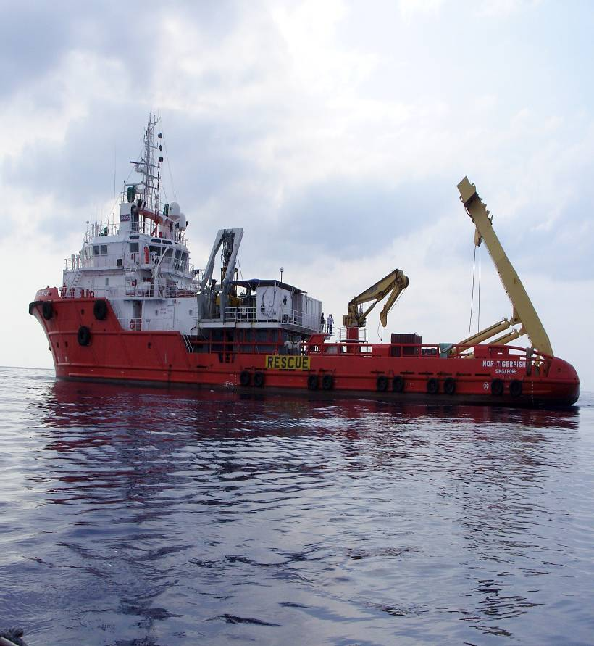

Oil & Natural Gas Industry
Underwater Unexploded Ordnance (UXO) Solutions

Slide 2
Agenda
  Driving Forces
  History of UXO At-sea
  UXO Capabilities Offered
  Phases of UXO Solutions
  Mitigation
  The Future

Slide 3
Driving Forces
As Oil & Gas companies continue to explore deeper ocean resources in search of new drill sites, they will inevitably encounter more UXO hazards
Energy corporations in search of oil and gas (O&G) reserves must adhere to Bureau of Ocean Energy Management (BOEM) requirements:
    Maintain 50’ right of way either side of center of UXO
    Identify and declare all contacts and obstacles
    Pipe-lay corridor must be approved by BOEM
BOEM directives affect shallow, deep, and ultra deep water O&G projects differently

Slide 4
History of UXO At-sea
1920 – 1970 unregulated disposal in the Gulf of Mexico, Atlantic and Pacific Oceans (http://blogs.abcnews.com/theblotter/2007/07/underwater-tick.html)
Geographically widespread (Bearden, 2007)
  1800 – 1972: Conservatively, over 200M lbs. of ordnance dumped globally in oceans, lakes, rivers, etc.
  Includes chemical ordnance
  Military explosive dumping areas established but not necessarily used due to inaccurate navigation systems
Historical records poorly maintained

Slide 5
History of UXO At-sea
In North Americas inland and coastal waters, according to known records, there are 79 dumpsites. Here are several off the east coast (source: www.uxoinfo.com):
Atlantic, NY-01 Sea Disposal (U.S.)Atlantic Ocean (U.S)NY
Atlantic, VA-01 Sea Disposal (U.S.)Atlantic Ocean (U.S)VA
Atlantic, NC-03 (Area Baker) Sea Disposal (U.S.)Atlantic Ocean (U.S)NC
Atlantic, NC-04 (Area B-1) Sea Disposal (U.S.)Atlantic Ocean (U.S)NC
Atlantic, FL-02 Sea Disposal (U.S.)Atlantic Ocean (U.S)FL

Slide 6

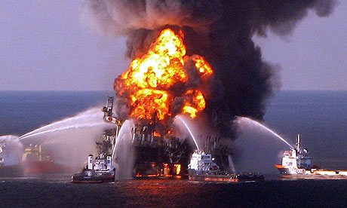
Benefits to the Customer
Some drilling and exploration vessels are leased to Oil & Gas customers at a rate of $500K per day.
There is also the additional overhead costs of fuel, food & water supplies, subcontractors and employee salaries.
Any damage to pipelines or well heads could incur significant liability on the Oil & Gas company as was witnessed during the Deep-water Horizon disaster.
Essentially, any delay in operations at sea incurs significant expense.

Slide 7
UXO Capabilities Offered
Historical munitions research for area of operation
Conduct comprehensive geological hazard surveys
Provide onsite support and ordnance expertise
Develop in-depth risk mitigation strategies
Ordnance & Chemical Warfare Agent Identification
Provide one on one training to ROV personnel

Slide 8
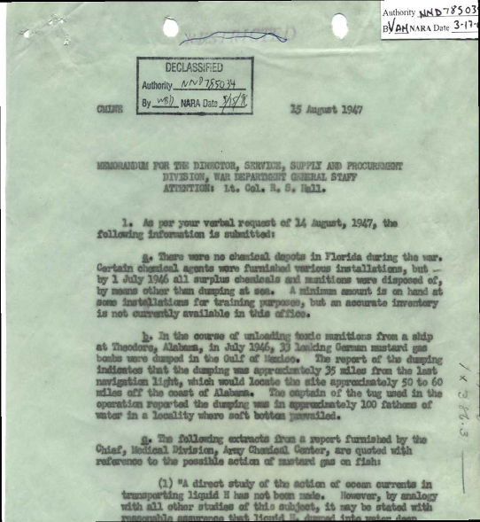
Phases of UXO Solutions
Phase I – Desktop Study
  Historical Research
    In-depth records research
    National Archives
    FOIA request
    Various services
    Army Corp of Engineers
  Provide refined ordnance research and analysis of historical data
    At-sea munitions dumping practices
    Ordnance type
    Probable fuzing components
    Safe/armed condition
    Environmental effects
    Initial risk assessment/risk mitigation recommendations

Slide 9
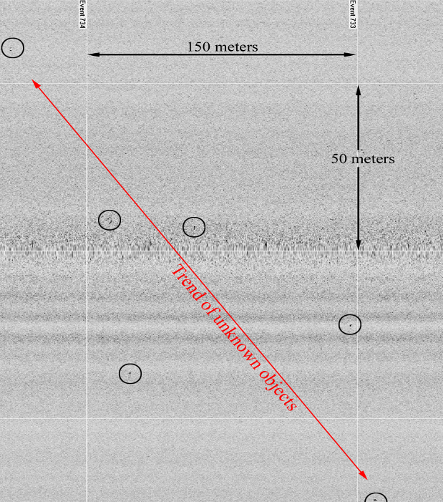
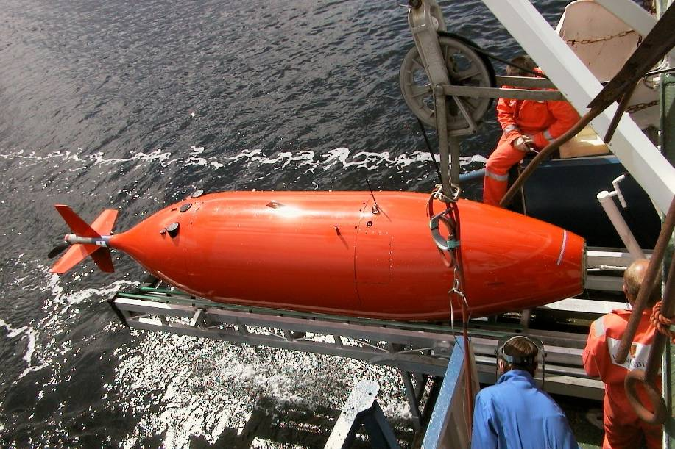
Phases of UXO Solutions
Phase II – AUV Survey
  Side scan sonar
    Interpretation of Side Scan Sonar Data

Slide 10
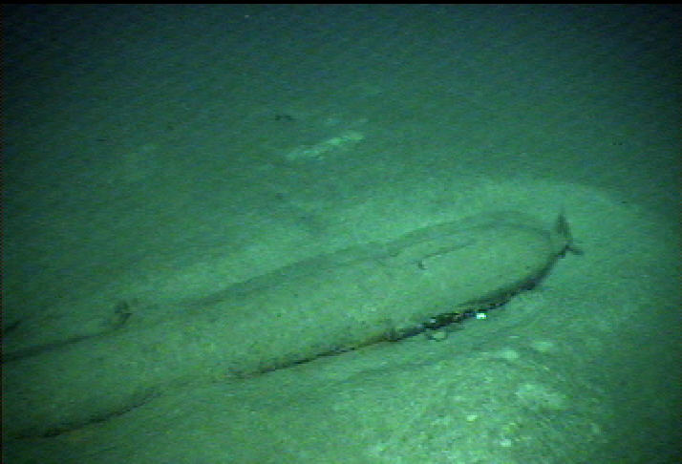
Phases of UXO Solutions
Phase III – ROV Survey
  ROV
    Photo / Video graphic Data
    Pulse Induced Gradiometric Data
    2 EOD specialists onboard to identify UXO and to work with ROV operators in a hazardous environment
  Produce final technical report

Slide 11
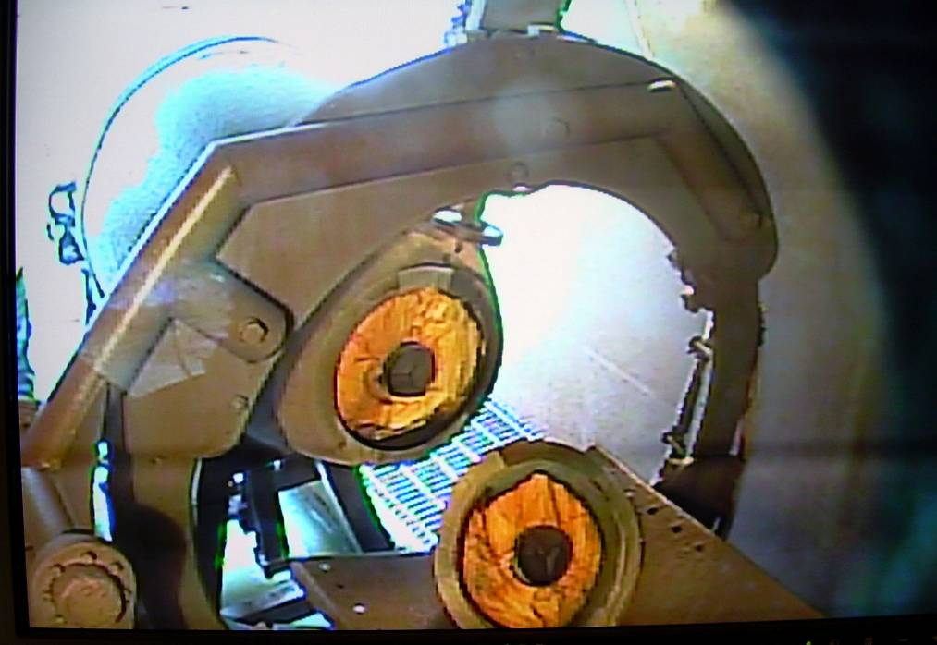
Phases of UXO Solutions
Phase IV – Mitigation
  Avoidance
    Preferred method
    Easily accomplished in deep and ultra deep waters
  Relocation
    Second option
    Specially equipped ROV will move UXO to a safe distance
  Safe Disposal
    Water jet technology
      Recycle materials
      Environmentally sound
      Conducted remotely

Slide 12
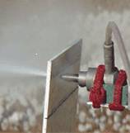
Mitigation Technology
High Pressure Abrasive Water jets are intrinsically safe
  Physical process safety validated by both theoretical and empirical research
  Approximately 2 million high-explosive munitions demilitarized without incident
Water jets are indiscriminate
  Water jets cut steel, copper, aluminum, rock, and explosives without requiring process changes
Less damaging to environment than other alternatives
Special lasers are showing promise for underwater cutting applications and may soon be developed for UXO applications.

Slide 13
The Future
This innovative method for mitigation of underwater UXO has applications well beyond the oil and gas industry.
  Current research shows that these UXO are slowly degrading and leaching contaminants into the environment
  The financial industry is pushing the installation of underwater fiber optic cables to provide faster connectivity to important financial transactions (Dan Joling, “Global warming opens up Arctic for undersea cable,” 2010)
  The push for renewable energy has provided opportunity in offshore wind and solar farms, as well as, tidal and wave energy systems
  UXO are not just a problem underwater, they are a problem on land as well.

Slide 14
In Review
The driving forces of the underwater UXO problem
A brief history of underwater UXO
The services SAIC is capable of offering and why they’re needed
Details about the services and what sets us apart from the competition
Potential areas for future expansion

Slide 15
What We Need
Funding to hire four qualified EOD Technicians
Beginning travel budget of $35k
Support from Business Development
IR&D Budget of $75k to complete development of the underwater water jet

Slide 16
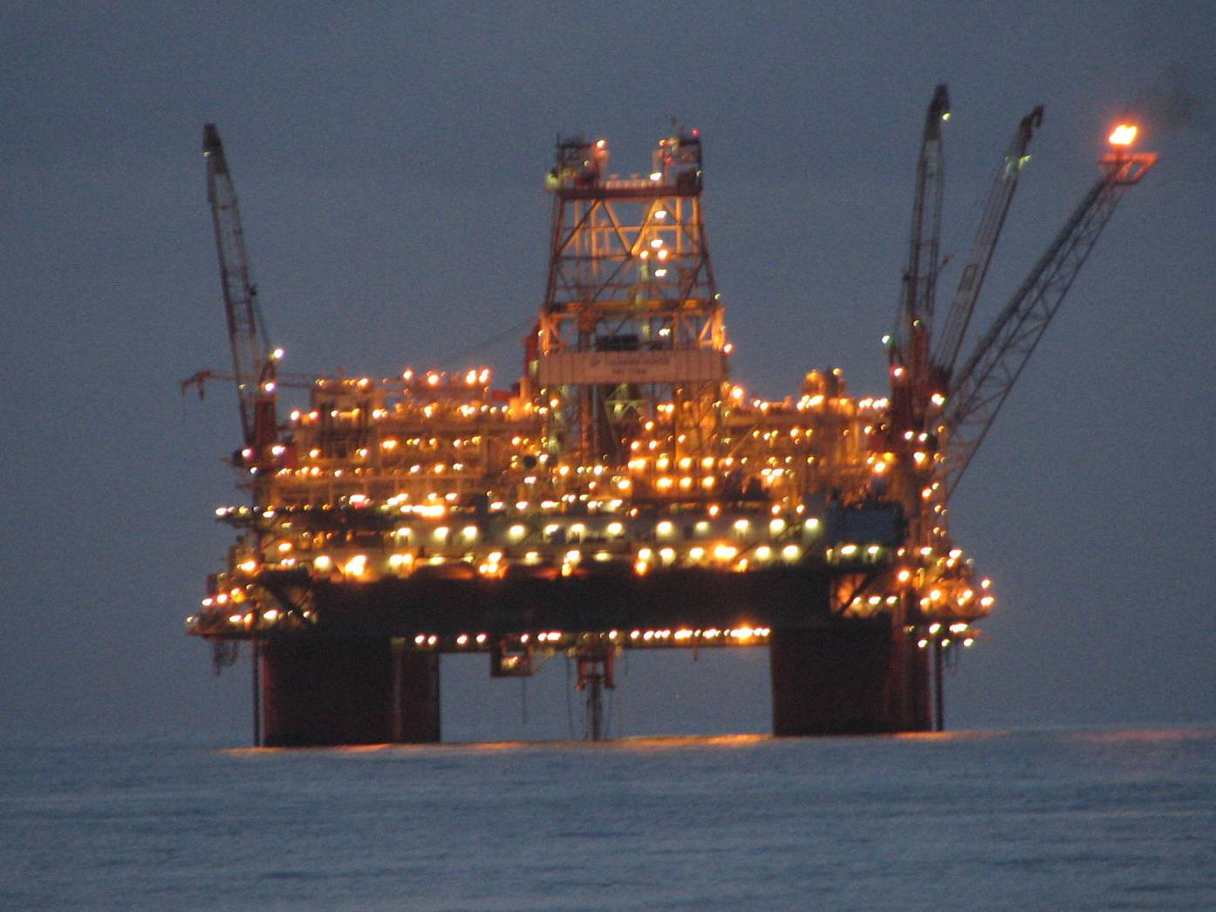
Questions
Paul Seely, SAIC EOD Specialist
757-383-3619
Paul.j.seely@saic.com

Slide 17
References
Bearden, David M. (2007), U.S. Disposal of Chemical Weapons in the Ocean:
Background and Issues for Congress. http://www.fas.org/sgp/crs/natsec/RL33432.pdf
Joling, Dan (2010, January 21). Global warming opens up Arctic for undersea cable.
USA Today. http://www.usatoday.com/tech/science/environment/2010-01-21-arctic-ice-undersea-cable_N.htm

